Slide 1
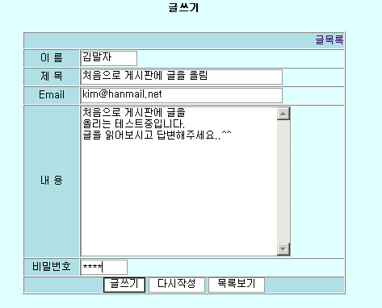
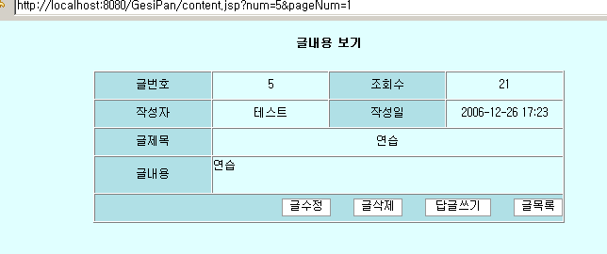
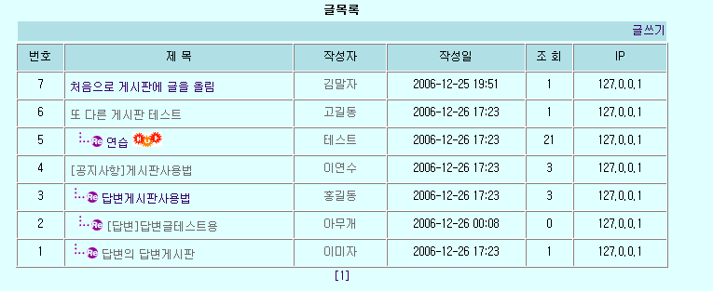
답변글쓰기
num,ref,re_step,
Re_level(답변글)
writeForm.jsp
content.jsp
writePro.jsp
insertArticle
(BoardDataBean article)
list.jsp
BoardDBMgr
DBConnectionMgr
Board

Slide 2
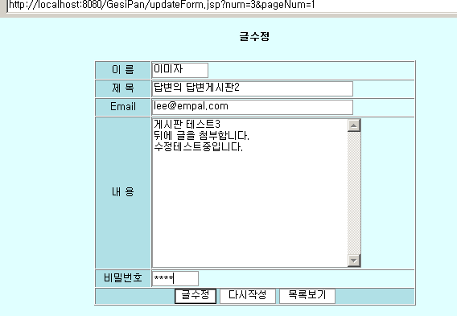
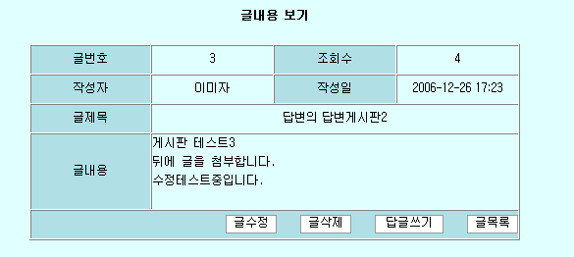
게시판 글수정하기
pageNum,num
updateForm.jsp
content.jsp
pageNum
updatePro.jsp
list.jsp
updateArticle(article)
BoardDBMgr
DBConnectionMgr
Board

